Slide 1

Task 1 Presentation
Omar Abdelwahab Saber Esswi
EDA and Data Visualization for a Hotel Reservation Data Set

Slide 2

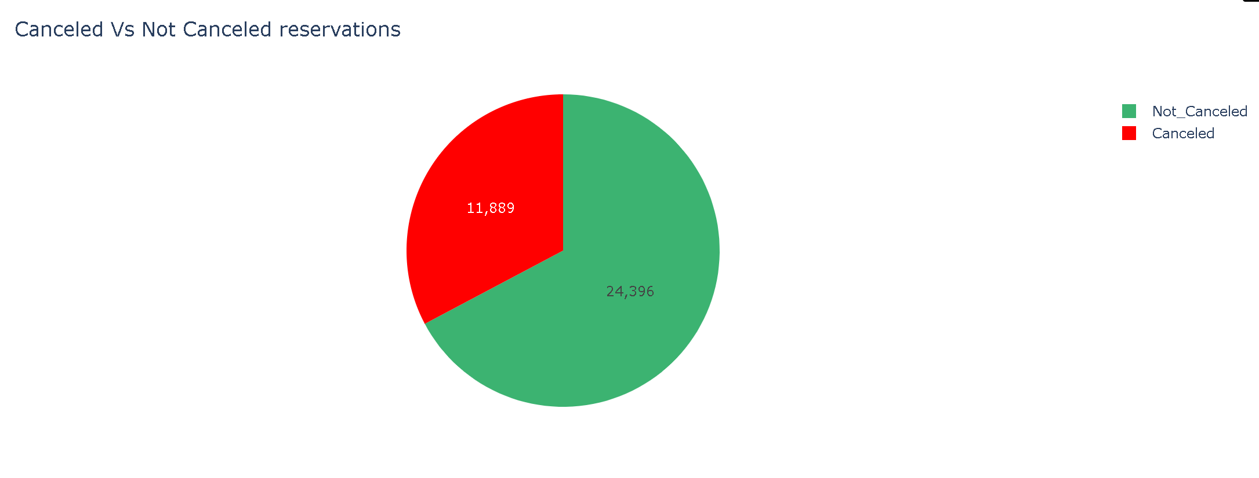
Question 1: What is the distribution of booking statuses (Canceled vs. Not_Canceled)
Graph will be added here
The data shows that approximately 68% of reservations (24,396) were not canceled, while 32% (11,889) were canceled, indicating a significant proportion of bookings end in cancellation.

Slide 3
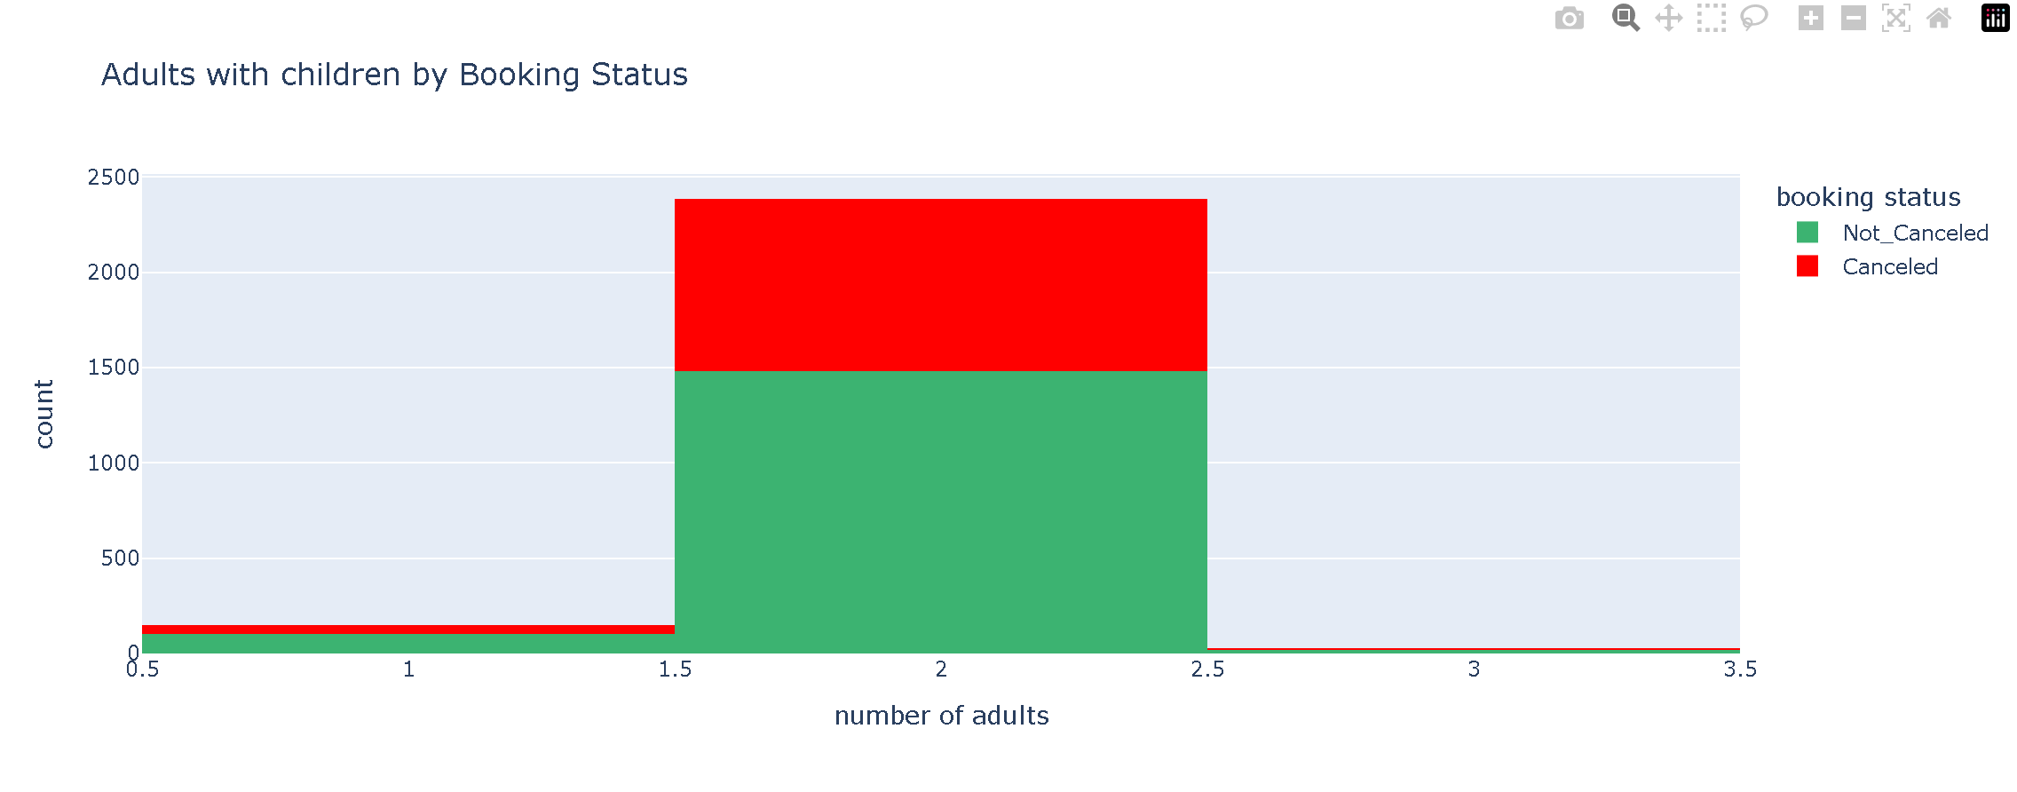
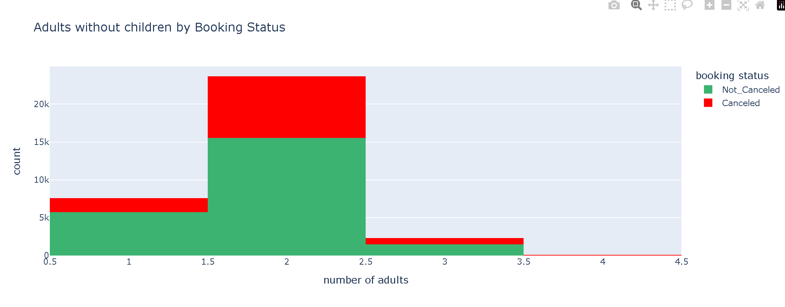
Question 2: Does the presence of children affect adult reservation behavior?
Graph will be added here
The presence of children does not significantly affect cancellation behavior, as both groups show nearly the same cancellation rate (~38–39%). However, adults without children make more total bookings, resulting in a higher number of cancellations in absolute terms

Slide 4
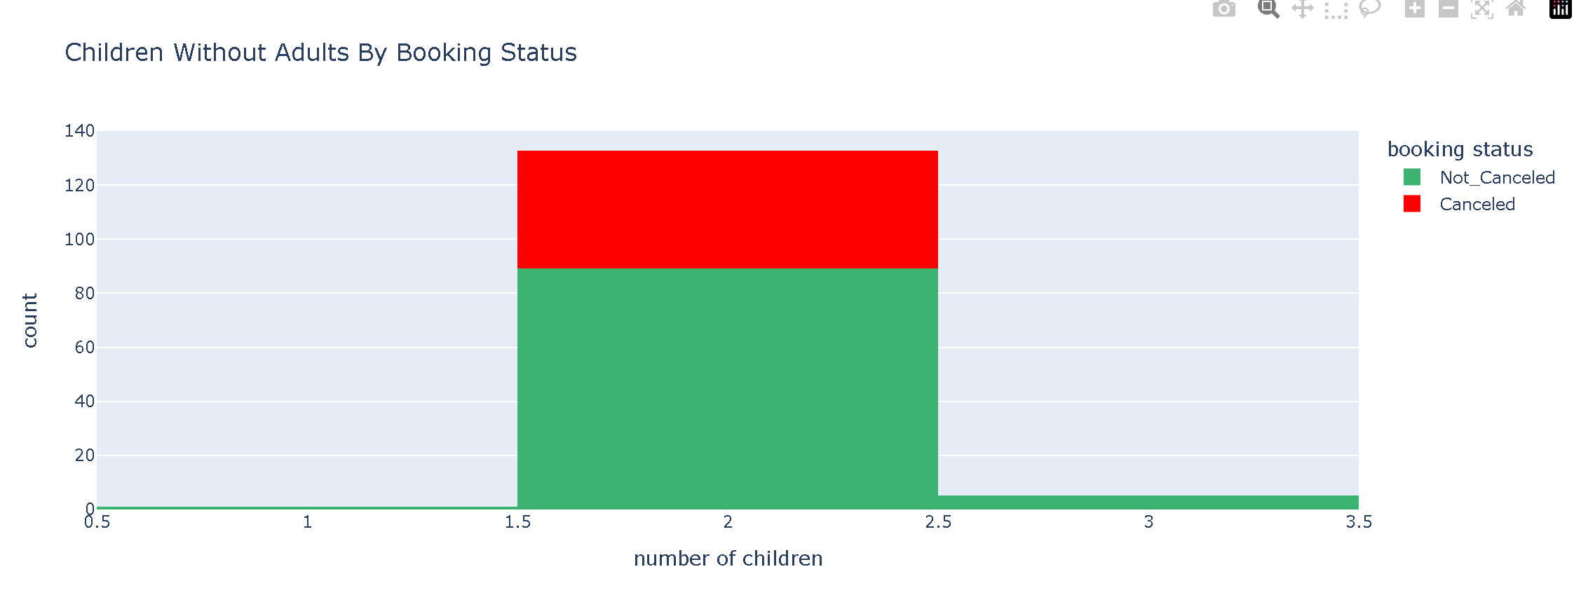
Question 3: Does the absence of adults in bookings with children affect the likelihood of cancellation?
Graph will be added here
The data shows that bookings with children but no adults (which are unusual cases) have different cancellation patterns based on the number of children, with bookings having 3 children showing no cancellations at all

Slide 5
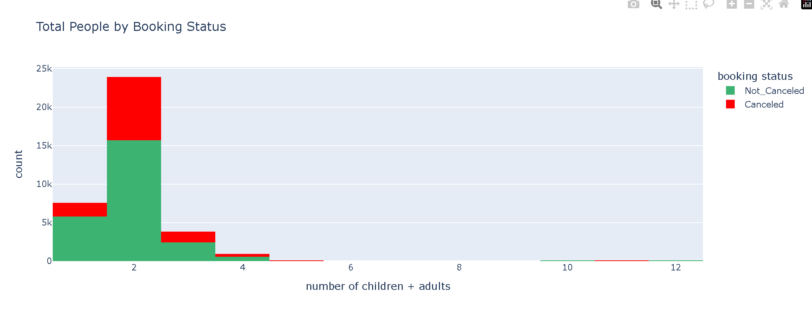
Question 4: Does the total number of people in a reservation affect the likelihood of cancellation?
Graph will be added here
The data generally indicates that as the total number of people in a reservation increases, the proportion of cancellations tends to decrease. While smaller groups (1-3 people) show a higher rate of cancellations, observations for very large groups (e.g., 5, 10, 11, and 12 people) should be interpreted with caution due to extremely limited sample sizes, where a single booking can lead to 100% cancellation or non-cancellation.

Slide 6
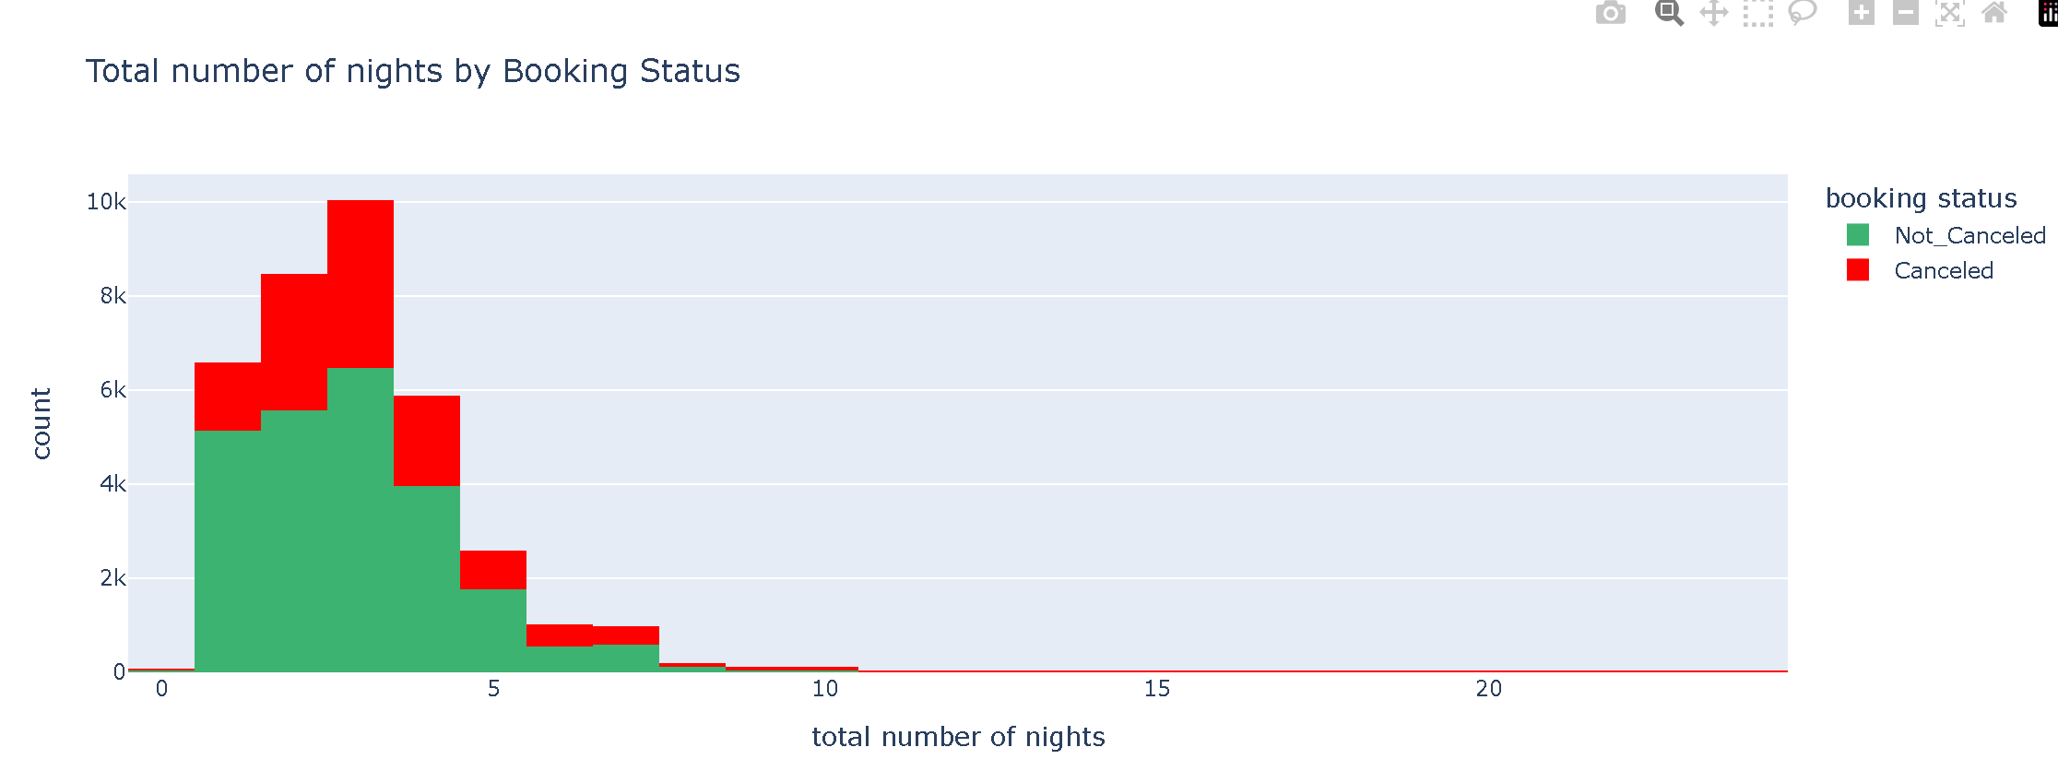
Question 5: Does the total number of nights (week + weekend) affect the likelihood of cancellation?
Graph will be added here
The total number of nights significantly affects cancellation rates. Shorter stays (1-3 nights) generally have a higher proportion of cancellations. For medium-length stays, the cancellation rate decreases, but for very long stays (e.g., 20+ nights), the cancellation rate appears to increase again, often exceeding the non-cancellation rate, though these instances represent fewer total bookings.

Slide 7
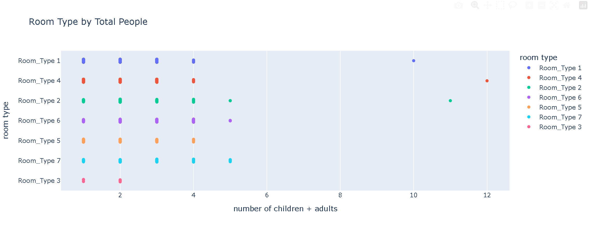
Question 6: Does the number of people in a booking affect the type of room selected?
Graph will be added here
Based on the available data, there is no strong, clear correlation indicating that the number of people in a booking significantly affects the type of room selected; various group sizes appear to utilize a wide range of room types.

Slide 8
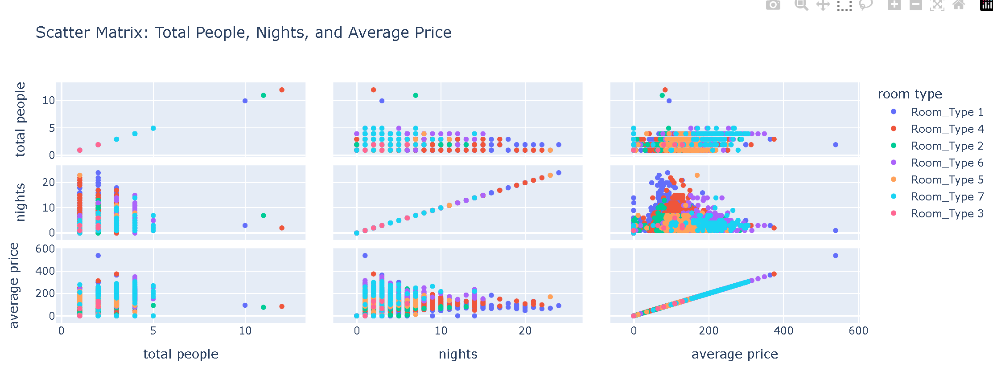
Question 7: How do the total number of people, room type, and number of nights affect the average price?
Graph will be added here
The average price is influenced by the number of people and room type. there appears to be no clear correlation between the number of nights and average price. Furthermore, for the number of people, the relationship with average price is complex and does not show a consistent upward or downward trend

Slide 9
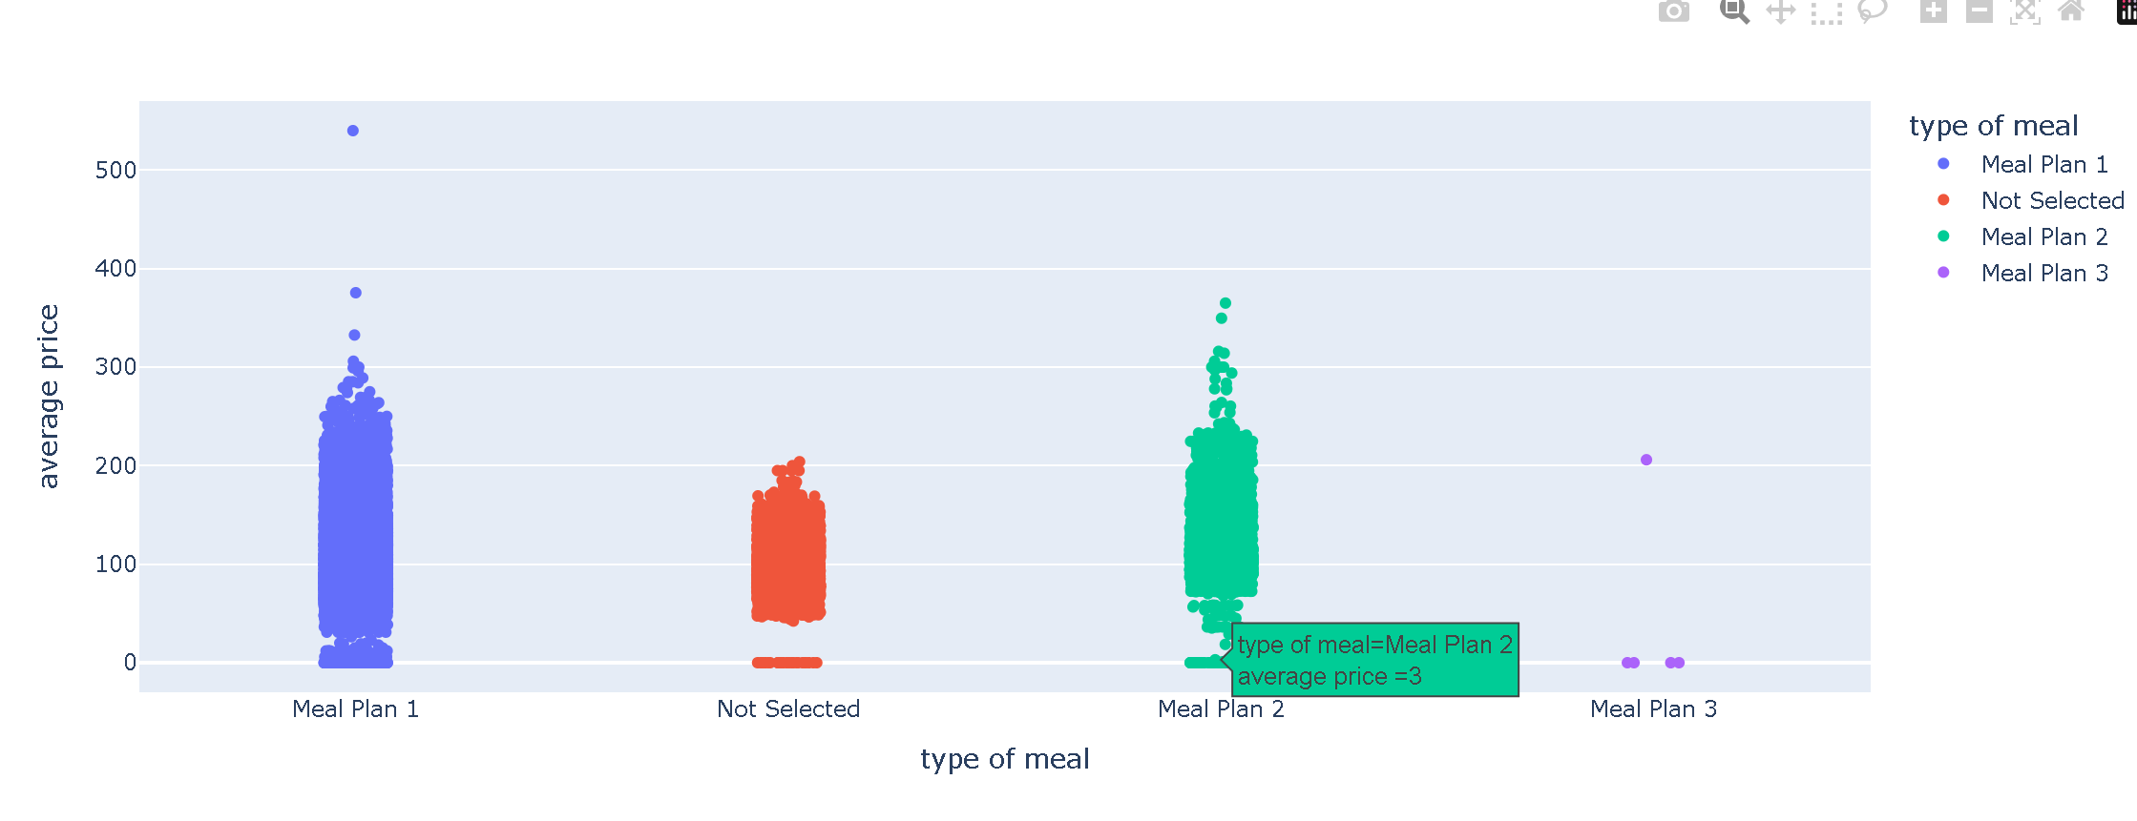
Question 8: How does the 'type of meal' affect the average price?
Graph will be added here
The meal type significantly impacts pricing, with Meal Plans 1 and 2 commanding higher average prices compared to "Not Selected" options, while Meal Plan 3 is rarely chosen and has the lowest average price.

Slide 10

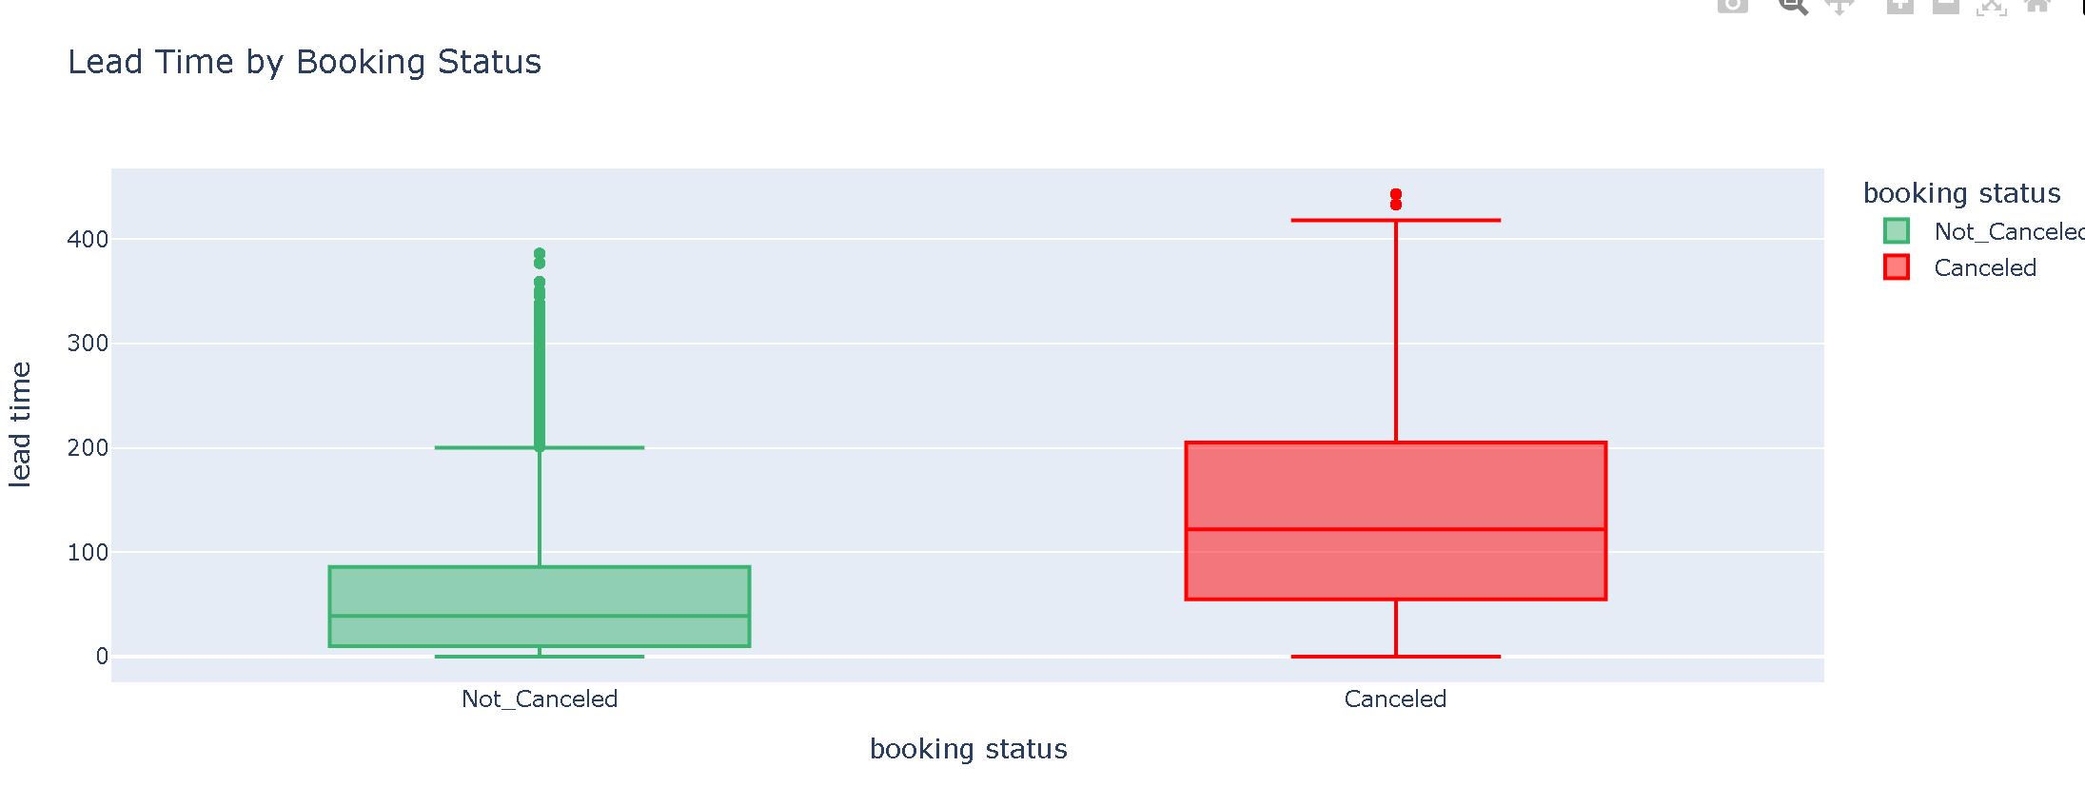
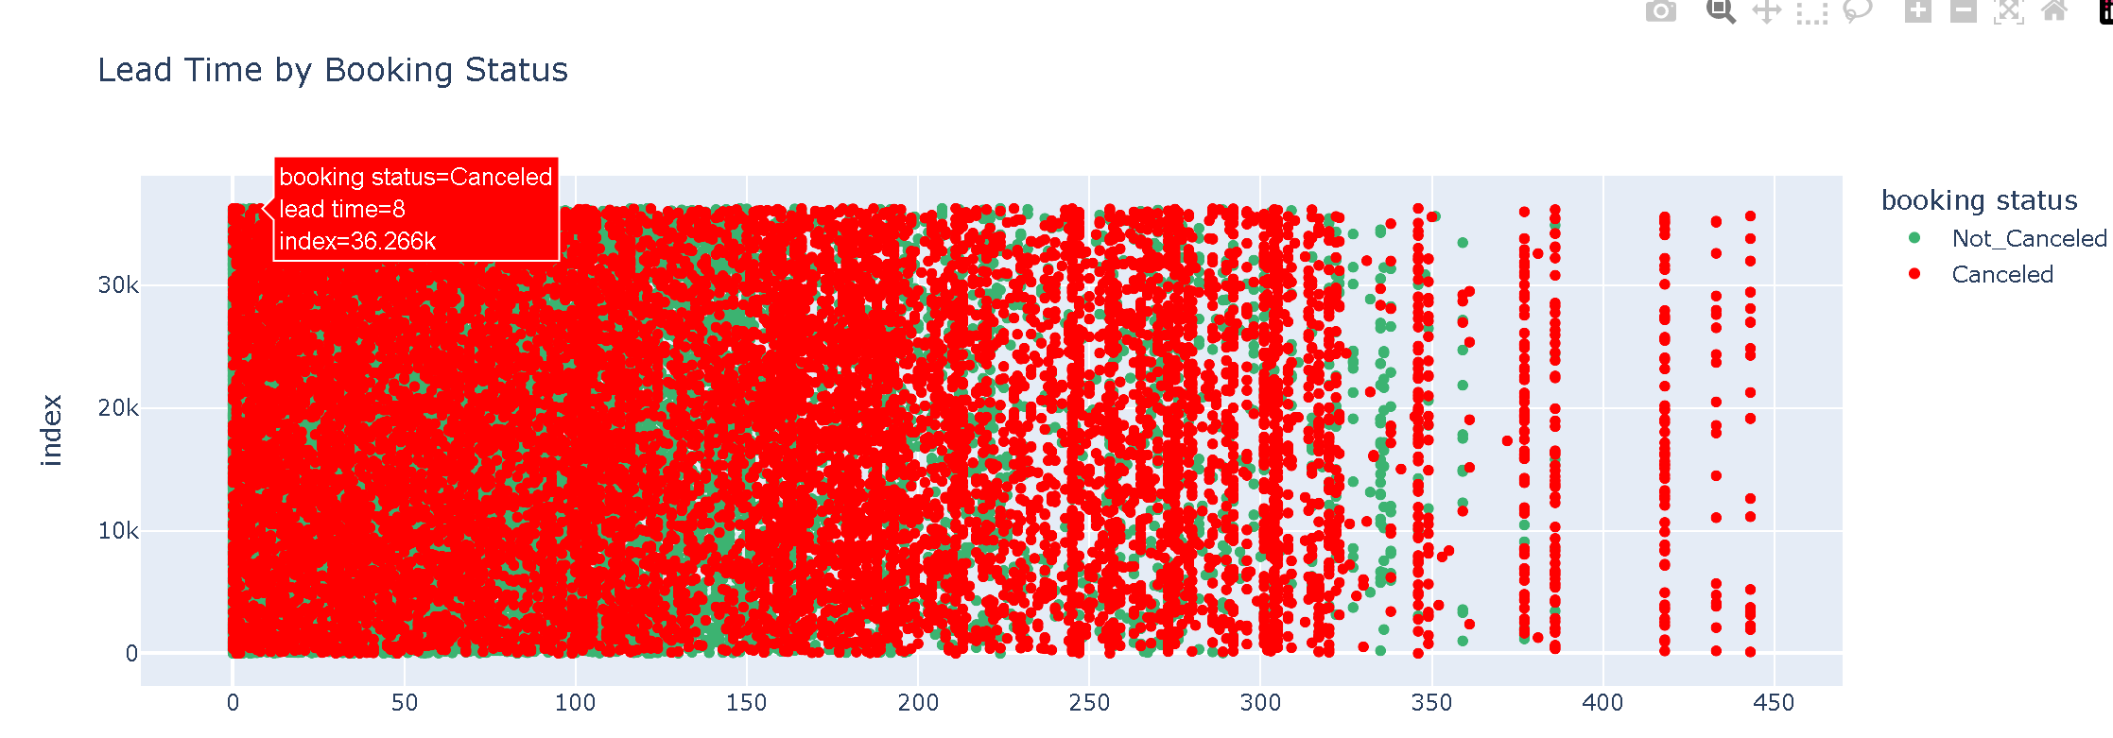
Question 9: Does lead time affect the likelihood of cancellation?
Graph will be added here
Yes, lead time significantly affects cancellation likelihood; as lead time increases, the cancellation rate also increases, reaching its maximum for bookings made far in advance, compared to those made closer to the stay date.

Slide 11
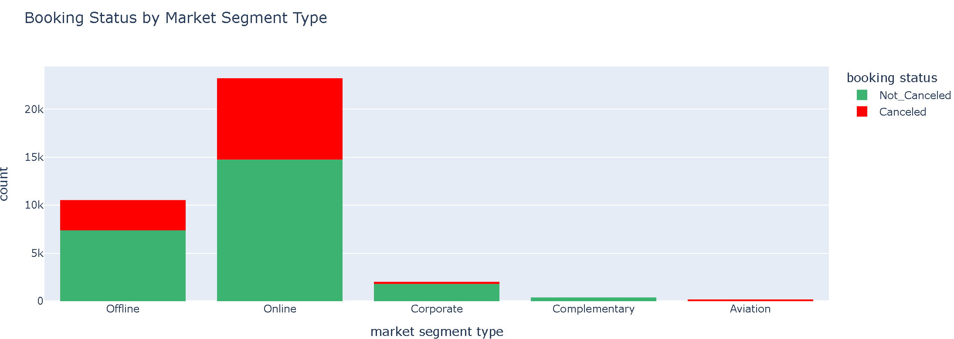
Question 10: How does the market segment type affect the likelihood of cancellation?
Graph will be added here
Market segment significantly impacts cancellation rates, with Online and Aviation segments showing higher cancellation rates, while Corporate and Complementary segments demonstrate notably lower cancellation rates.

Slide 12
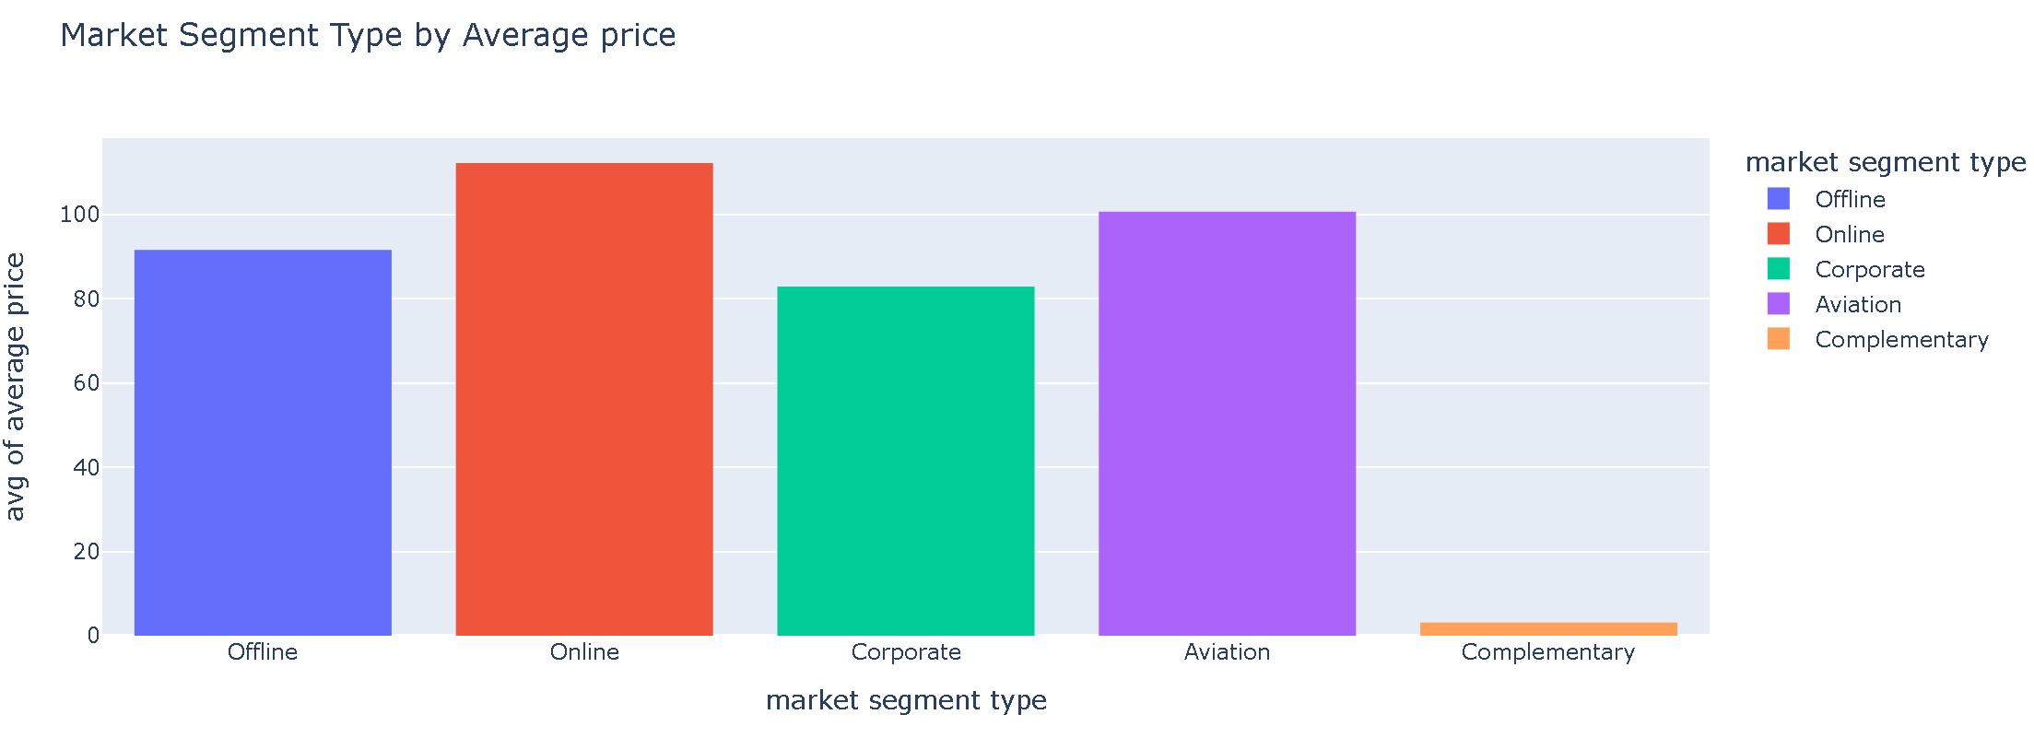
Question 11: Which market segment type has the highest average price?
Graph will be added here
The Online market segment has the highest average price (approximately 110 units), followed by Aviation (100 units), Offline (90 units), and Corporate (80 units), while Complementary bookings have the lowest price near zero

Slide 13
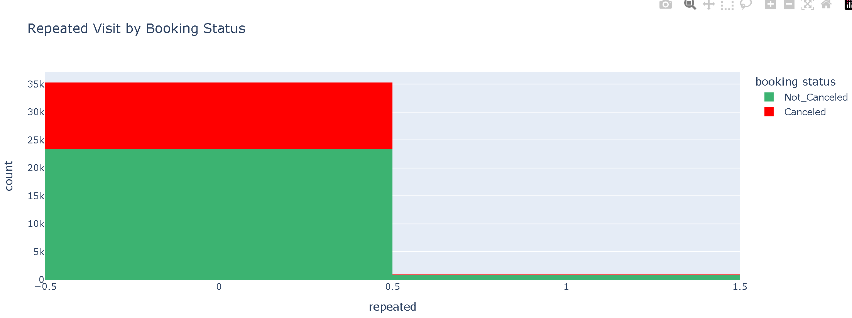
Question 12: Are repeated guests more likely to cancel their bookings?
Graph will be added here
The data shows very few repeated guests in the dataset, making it difficult to draw a definitive conclusion, though among first-time guests there is a significant proportion of both canceled and non-canceled bookings.

Slide 14

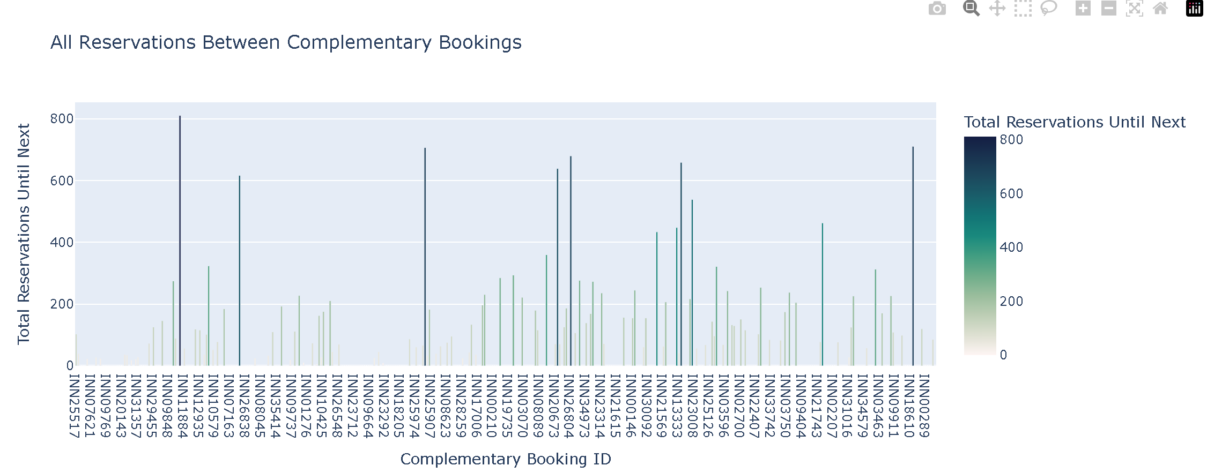
Question 13: For every complementary booking ID, how many reservations happened until the next complementary booking?
Graph will be added here
The data reveals significant variation in the total number of reservations occurring between complementary bookings. Certain complementary booking IDs are associated with a notably higher volume of total reservations, which could indicate their effectiveness as advertising channels or be influenced by other factors such as seasonal demand.

Slide 15
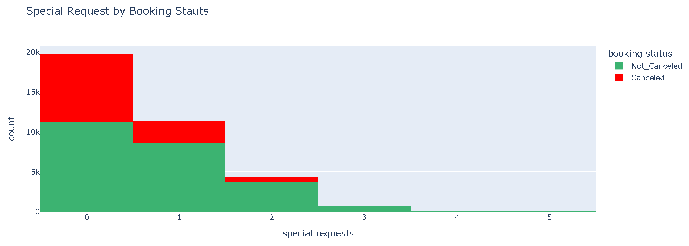
Question 14: How does the number of special requests impact the booking status?
Graph will be added here
The number of special requests strongly impacts booking status, with cancellation rates decreasing as special requests increase; bookings with 3+ special requests show very few cancellations, suggesting guests who make more special requests are more committed to their stay.

